Slide 1
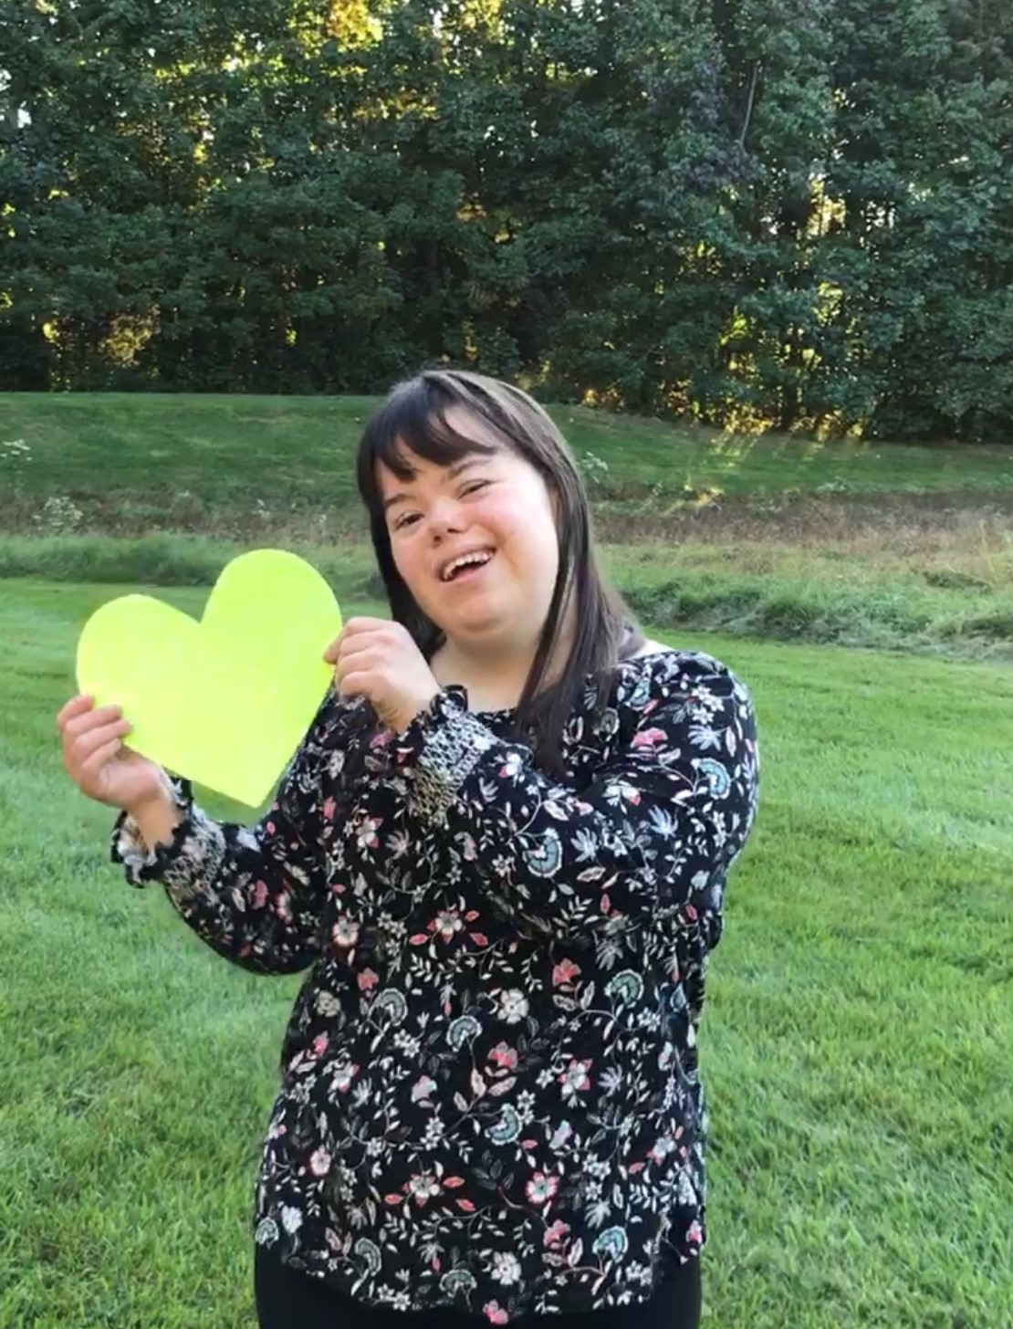
A
PASSION
FOR
ADVOCACY
Charlotte Woodward

Slide 2
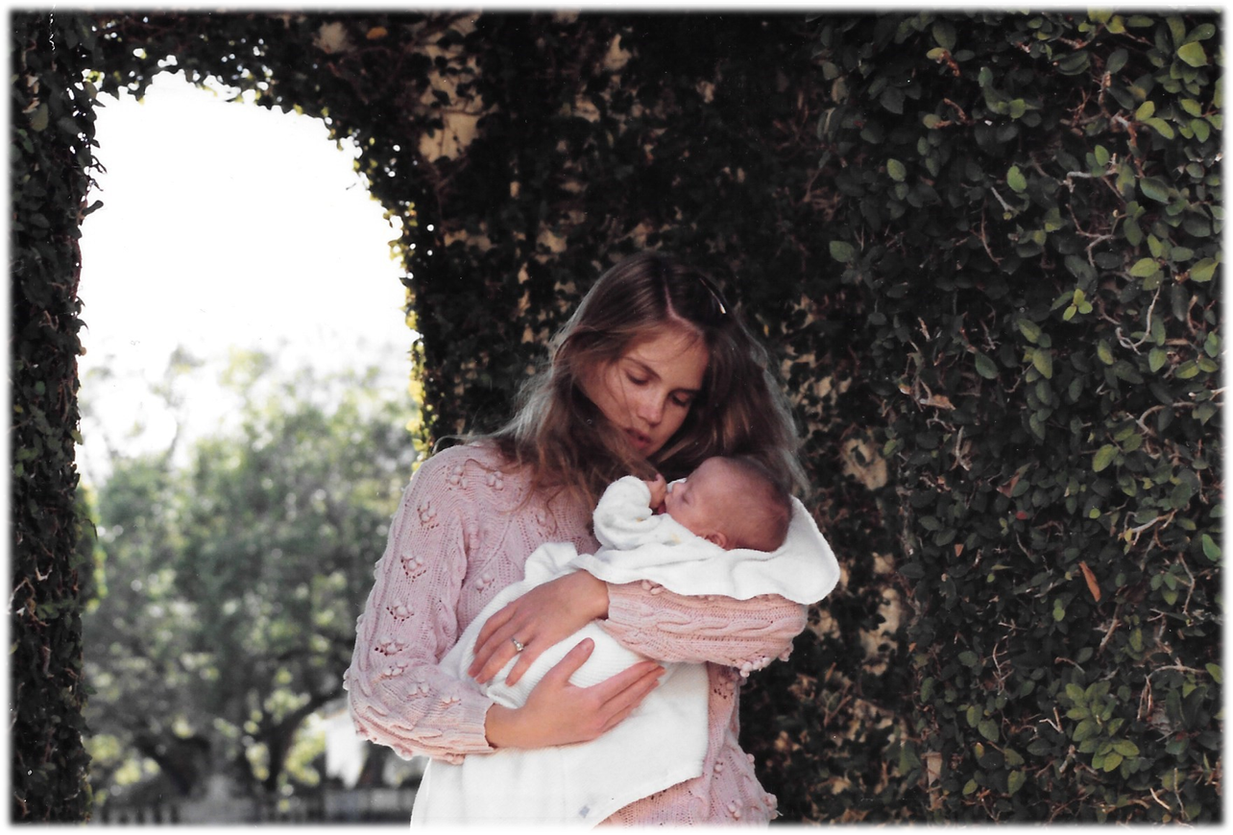
My mom and I, at the very beginning…

Slide 3
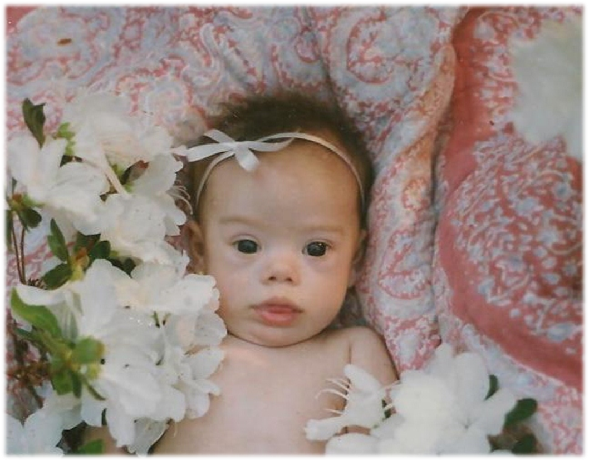
As a curious baby…

Slide 4
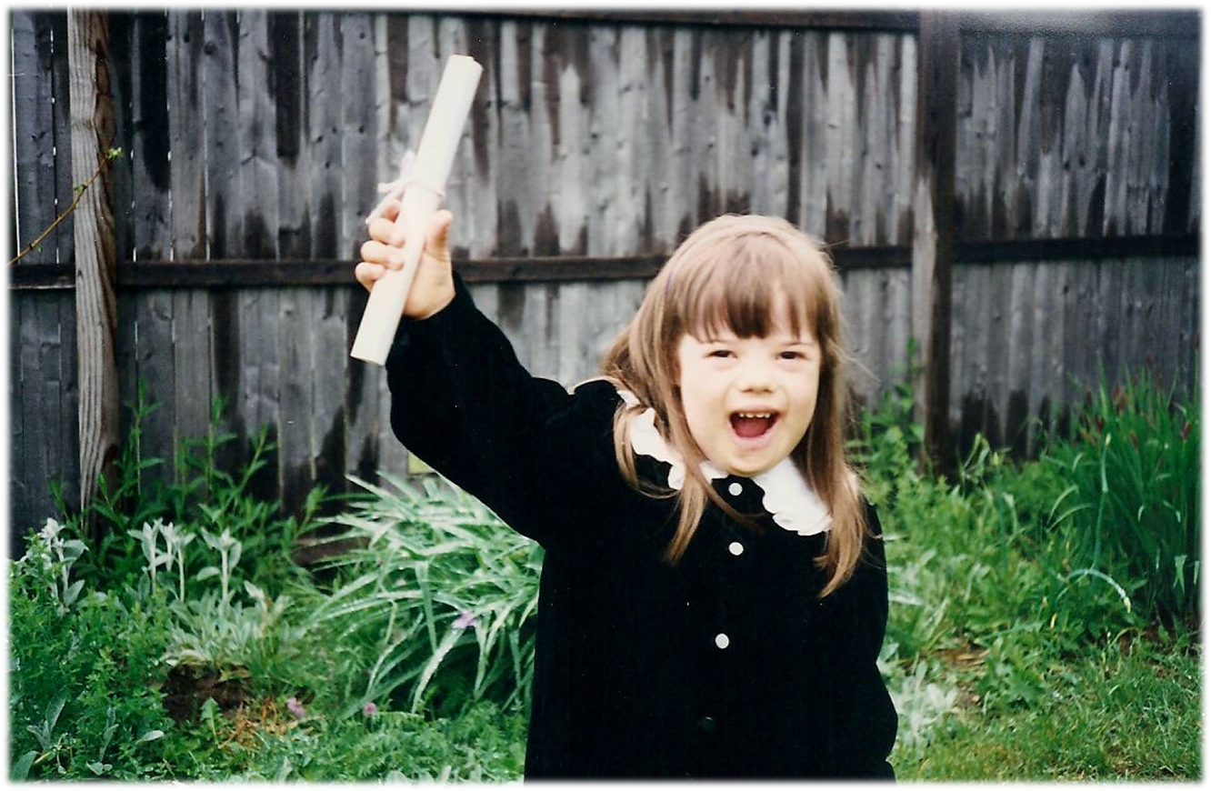
Graduation from preschool!

Slide 5
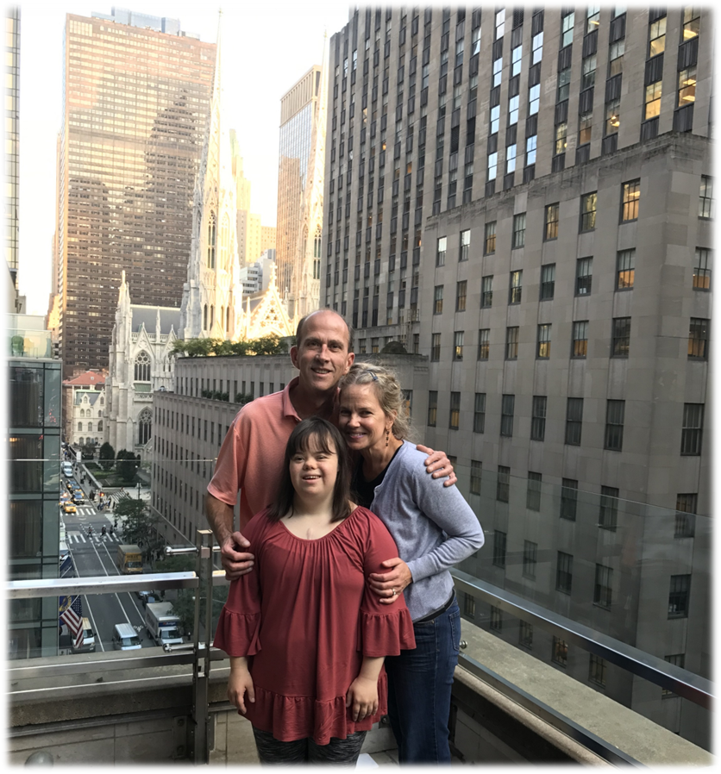
My biggest supporters!

Slide 6
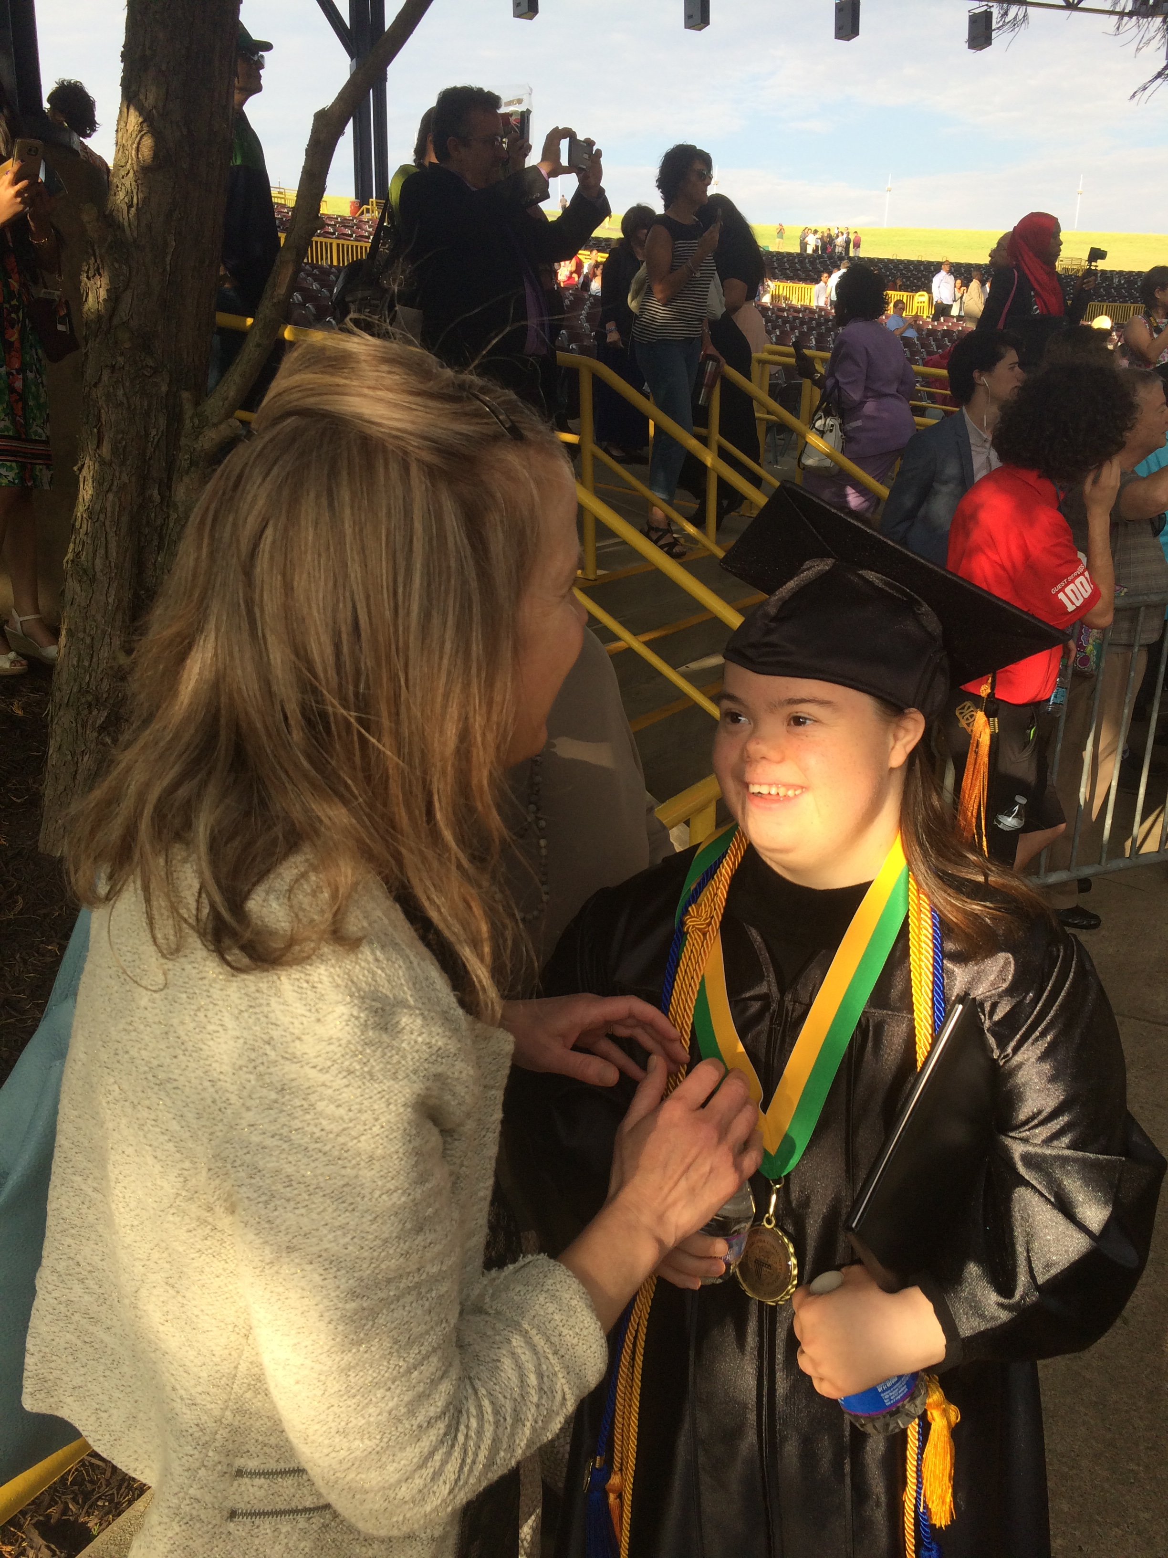
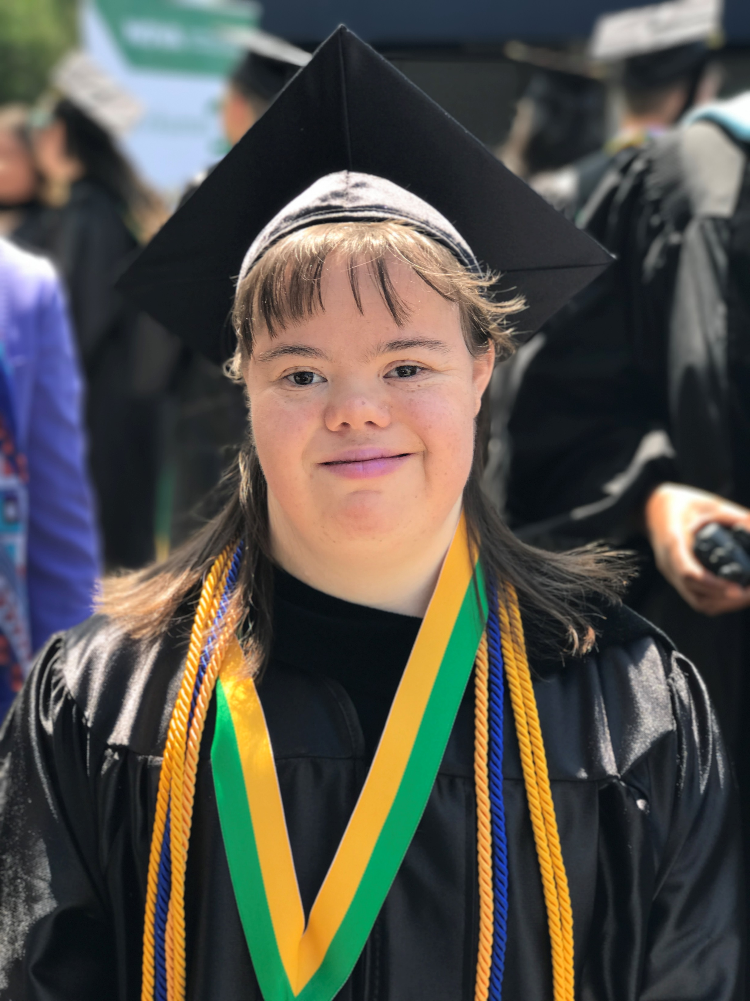
Graduation from Northern Virginia Community College!

Slide 7
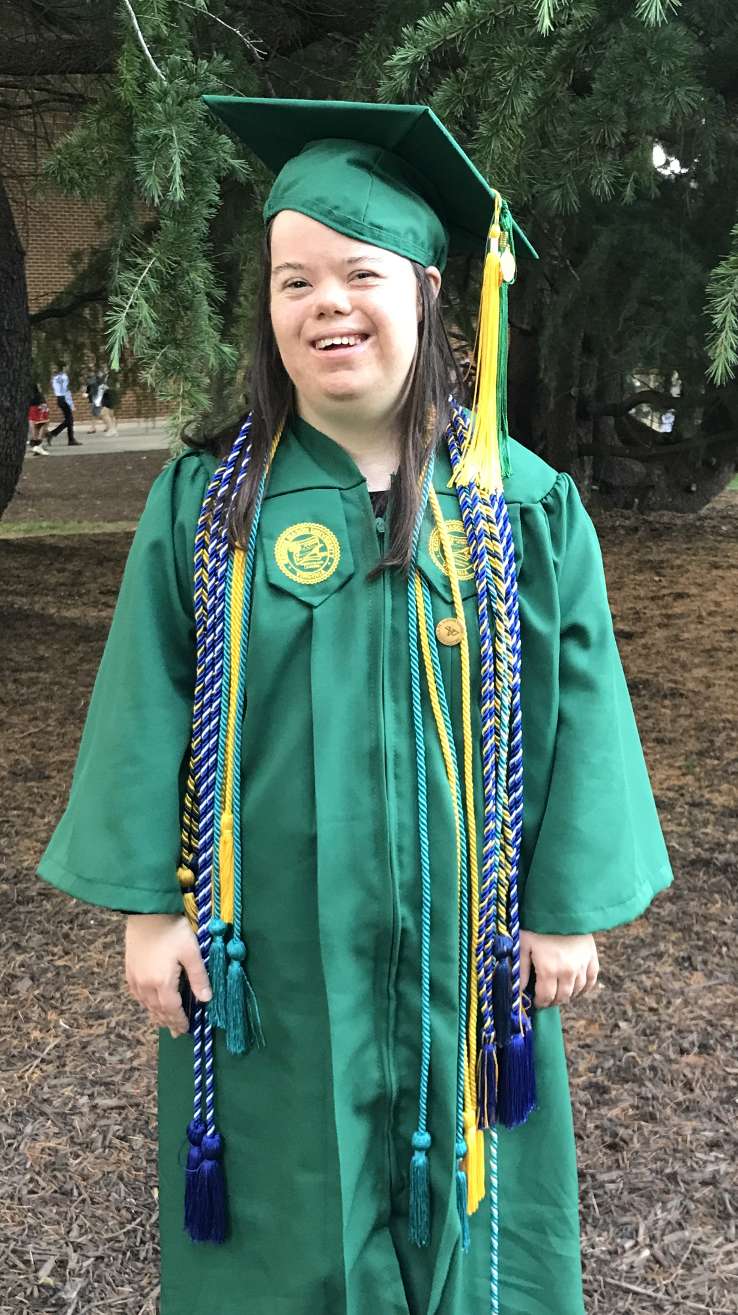
Graduation from George Mason University!

Slide 8
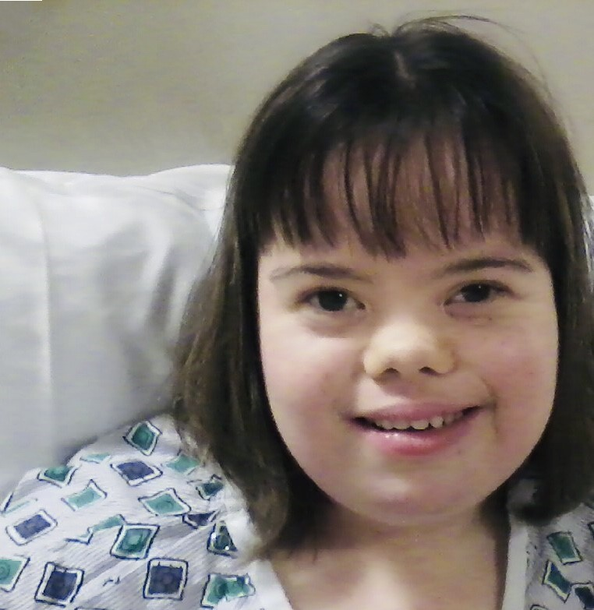
Recovering in the hospital after my life-saving heart transplant…

Slide 9
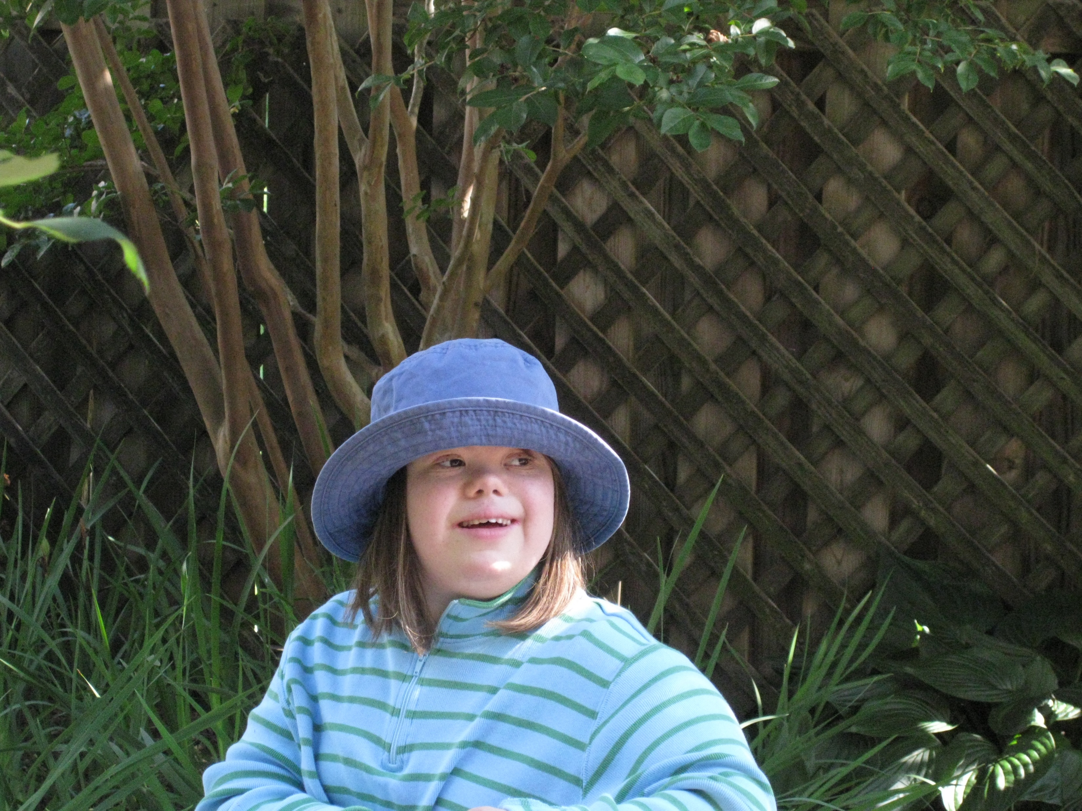
Happy and healthy soon after my heart transplant!

Slide 10
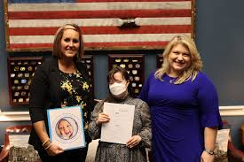
Celebrating the introduction of the Charlotte Woodward Organ Transplant Discrimination Prevention Act in the U.S. House of Representatives…

Slide 11
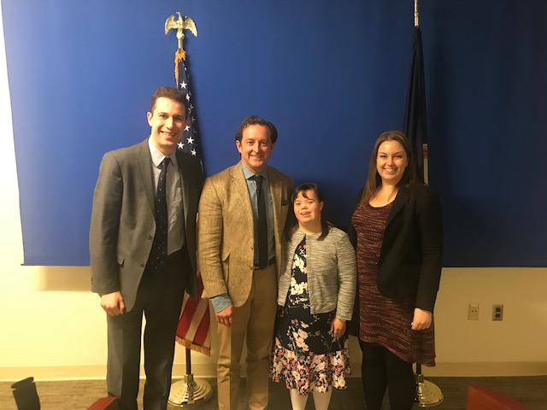
With a couple of my colleagues and a Virginia legislator, after testifying on nondiscrimination in organ transplantation…

Slide 12
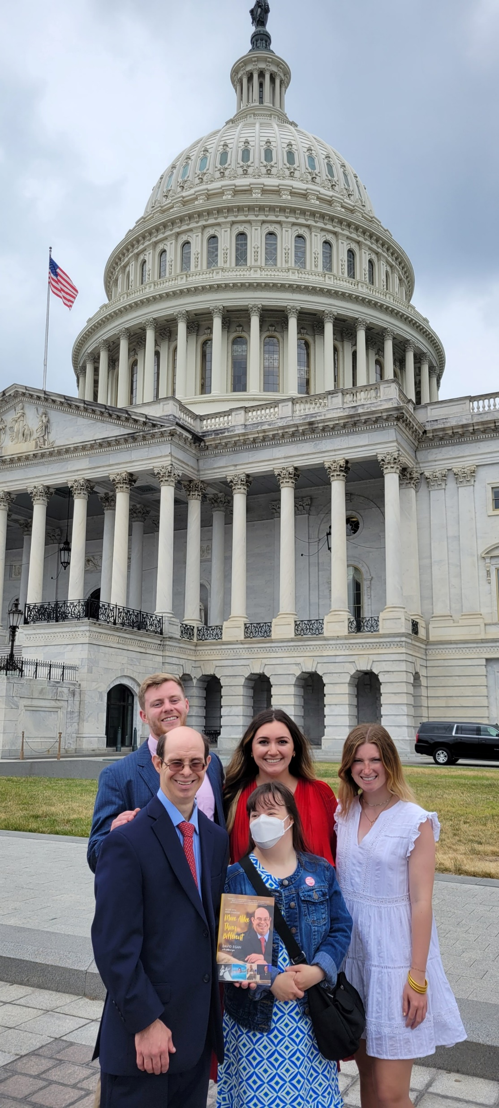
With some colleagues and a fellow self-advocate
at the U.S. Capital in Washington, DC…

Slide 13
Thank you
from the very bottom
of my heart!

