Slide 1





Learning Passport
Transforming Societies through Education
ILO Virtual Tech Fair
a partnership of

Slide 2

Designed to close the learning poverty gap, the Learning Passport is an online, mobile, and offline tech platform enabling high quality, flexible learning
Educational content
  Local digital teaching & learning materials, assessments
  Global supplementary materials available as needed
Strong alignment between curriculum framework, content, pedagogy, and assessment to drive learning outcome improvement
Learning Passport is a supplementary tool to support both formal and non-formal education programs, and will be aligned with education sector plans
Curriculum framework
  E.g., Math: grade 3, Literacy: grade 1
  Science: grade 2, English: grade 3
Technology platform
  Digital record of learning
  Teacher & learner interface
  Available online & offline
Supportive environment
  Psychosocial support
  SEL support system
  Peer support
SEL = Social and emotional learning
Note: In some instances, the LP may need to be deployed in non-tech settings, but the initial business plan has been designed with the offline tech deployment as the base case
Notes:
- Description of what the LP is – online offline mobile platform
- Can deliver national curriculum + global supplementary resources

Slide 3
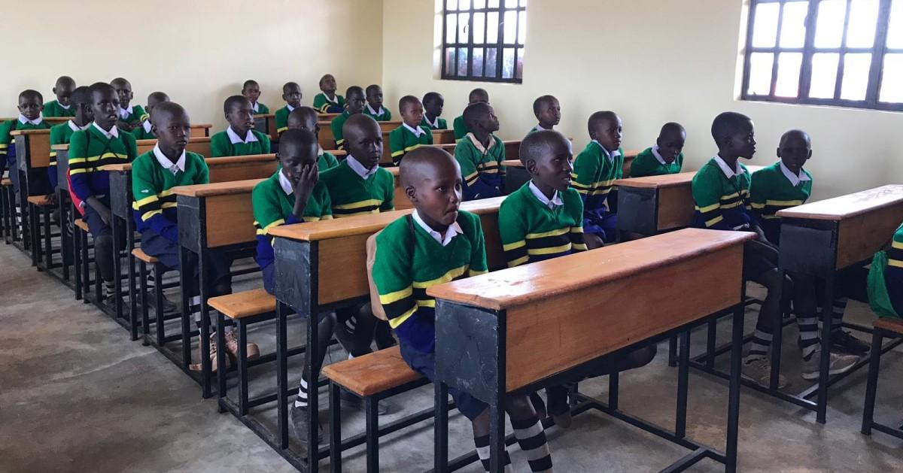


3 Ways to Reach Children
Our mission is to enable continuous access to education for all children, youth, and teachers around the world –and drive improved learning outcomes through high-quality, portable education to support their entry into other education or opportunity pathways, including formal education
Main Use Cases
Use Cases
Early Childhood Education
& Parents
Primary & Secondary Education
Technical & Vocational Education & Training
Teacher Trainings
Youth & Adolescent Skills
Formal
Non-formal:
Existing ed providers
Non-formal:
Prospective ed providers
e.g. government schools
e.g. learning centers
e.g. homes, community/religious centers

Slide 4
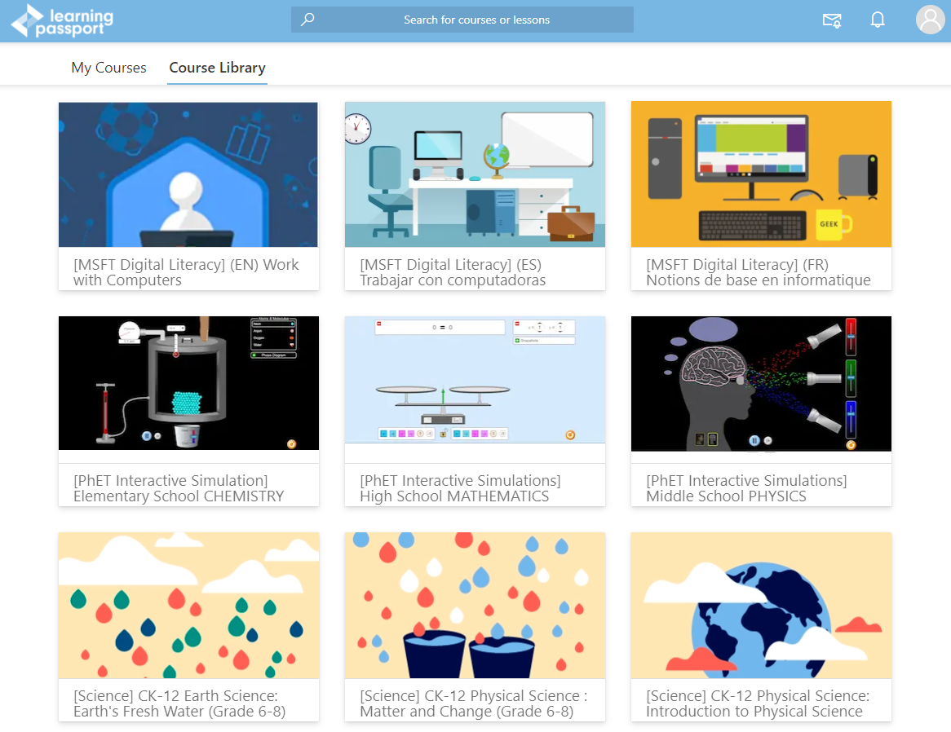
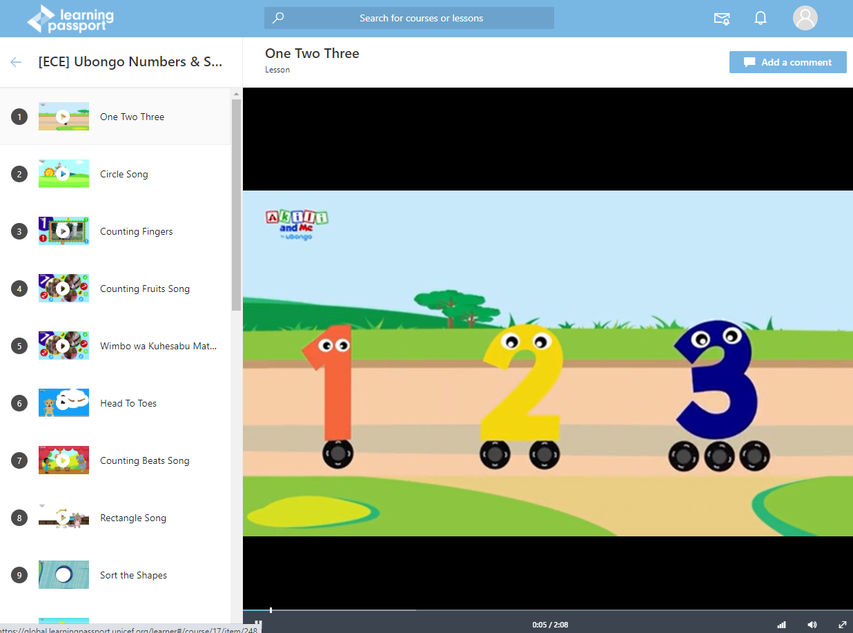
Course Library contains all content
Main User Interfaces of the LP
Sample Lesson Page

Slide 5
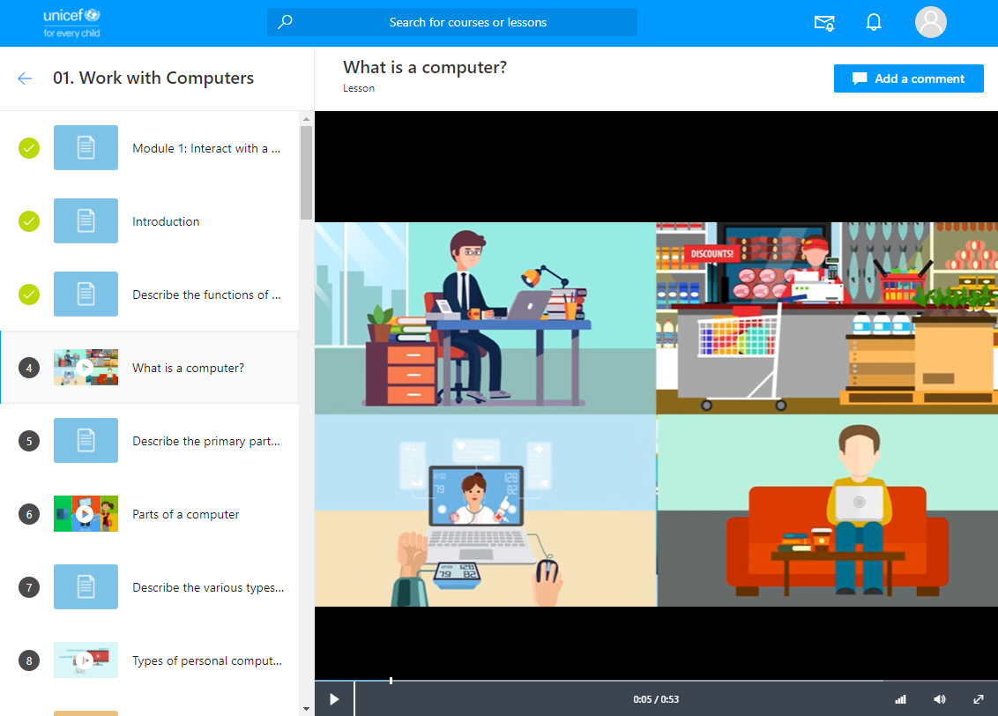
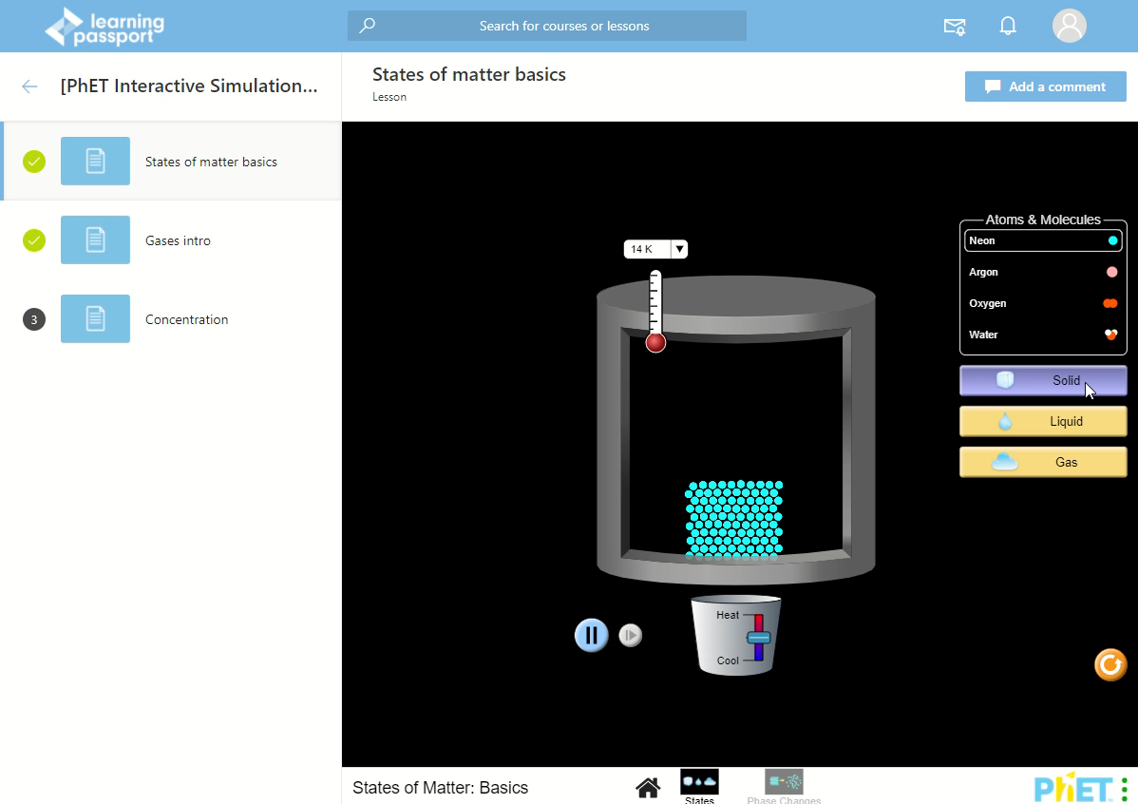
Digital Skills & Literacy
The Learning Passport includes content such as…
&
Interactive simulations and demos

Slide 6
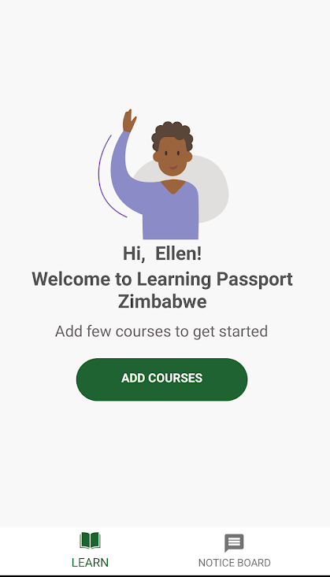
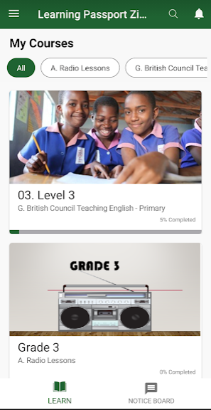
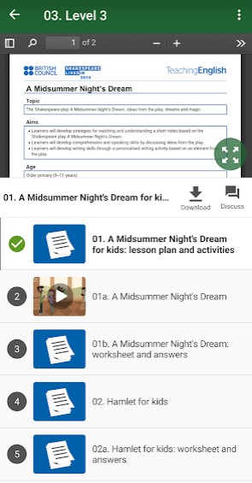
Access the LP via a Mobile App
Access learning materials here
See all your courses here!
See all your lessons

Slide 7
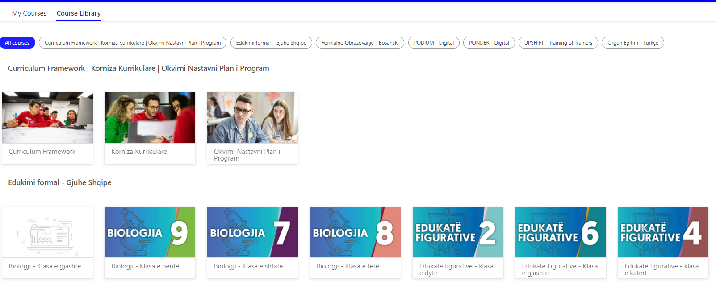
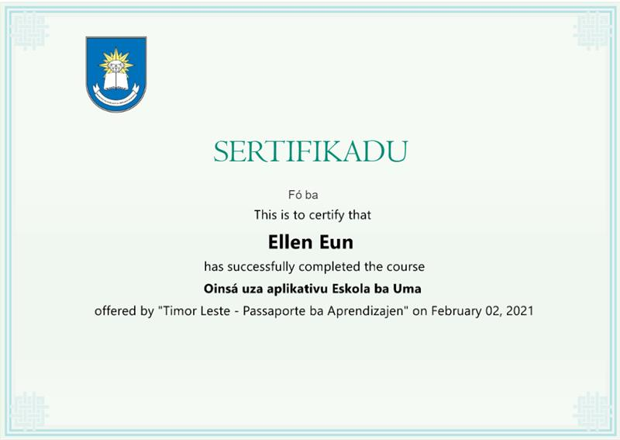
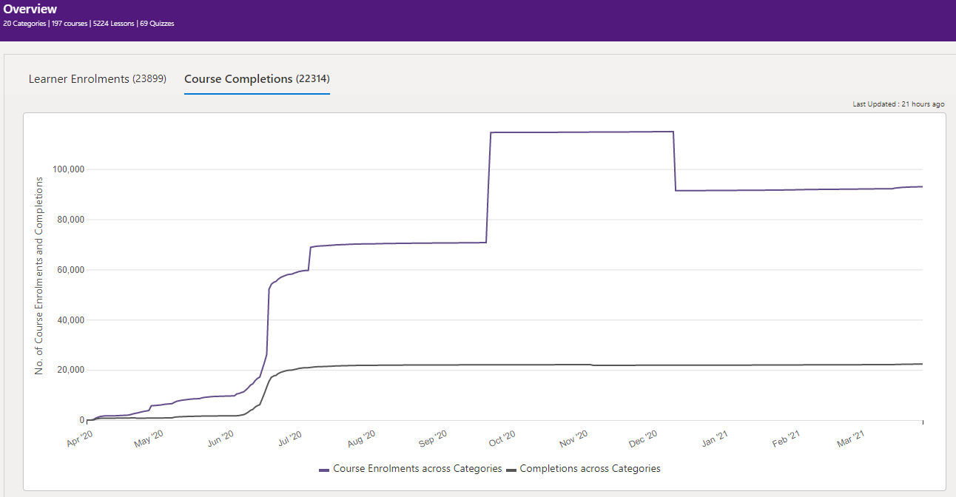
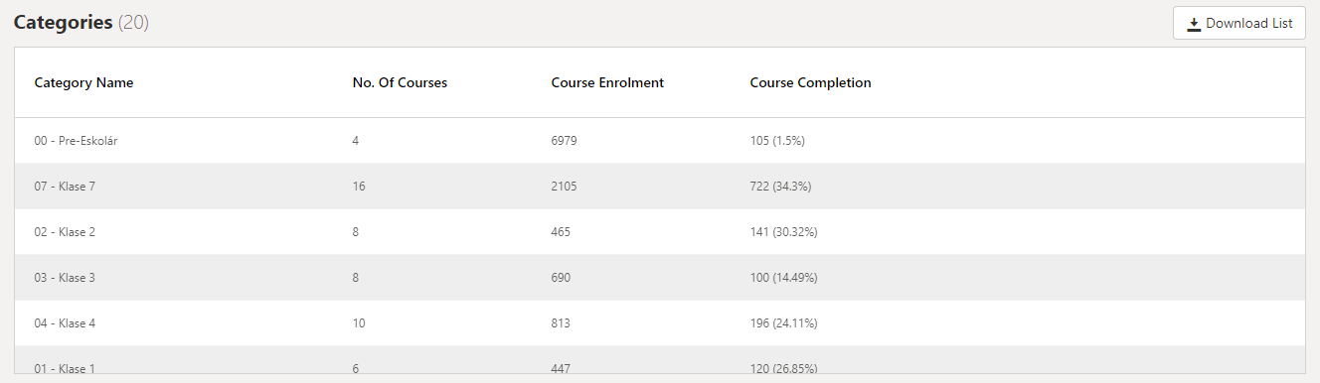
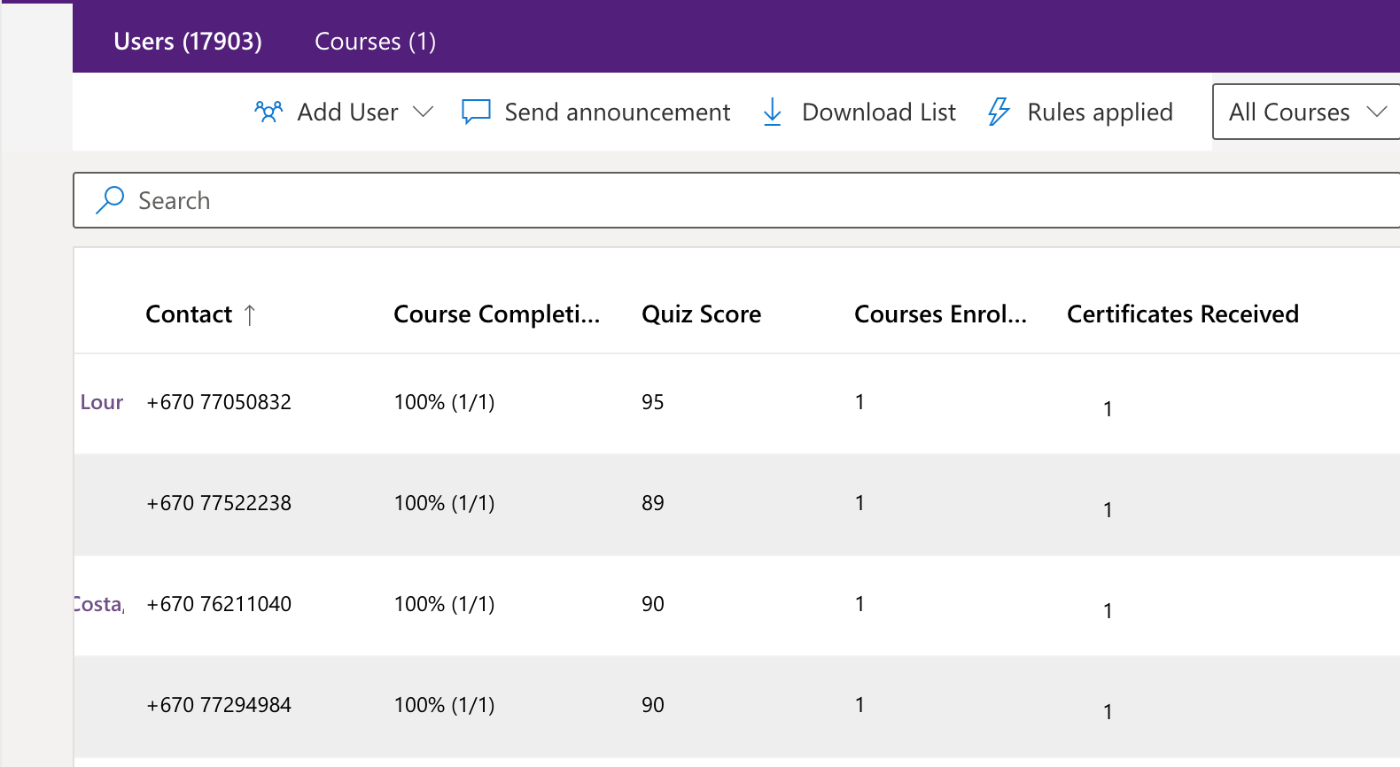
Benefits to Educators Using the LP
1. Course and learner management interface
3. Issue a certificate for completed courses
Easily organize courses under “Course Library” and “My Courses”
Course organized by subject and grade for easy viewing
2. Track a learner's progress using the analytics dashboard
Overall analytics
Analytics for each course
Quiz scores for specific courses

Slide 8
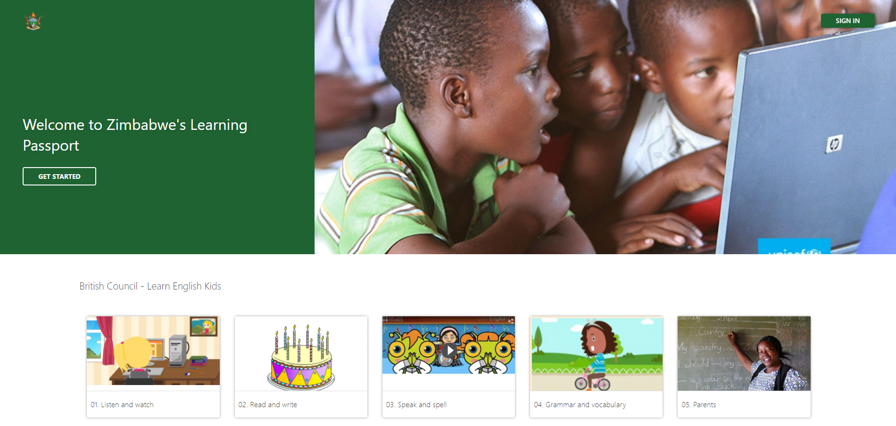
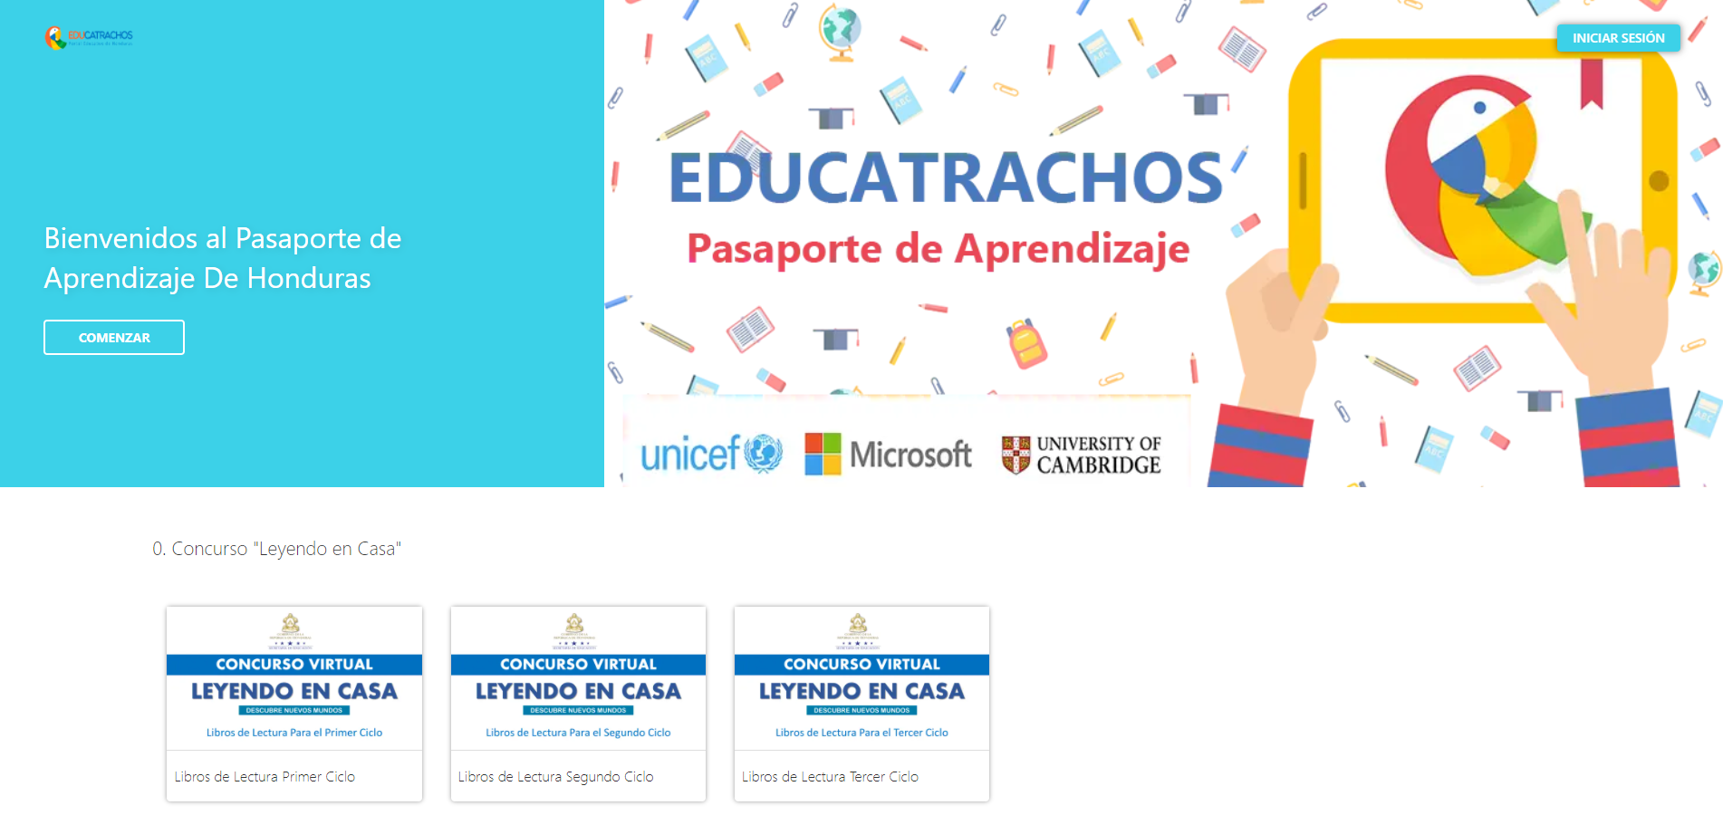
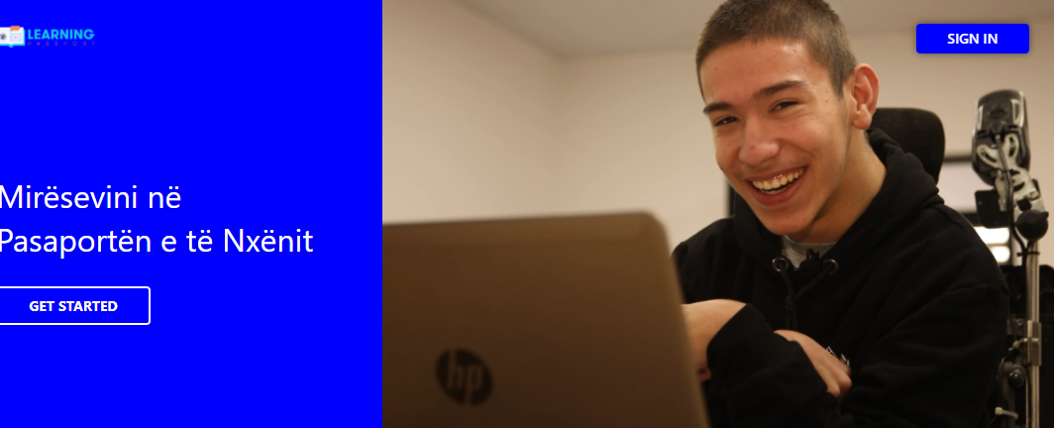
The Learning Passport launched in 8 countries and is in development in over 20+ countries
Country:
Zimbabwe
Modality:
Online & Mobile
Use Case:
National Primary & Secondary Digital Learning Platform
Country:
Honduras
Modality:
Online, Mobile & Offline
Use Case:
Complement the National Digital Learning Platform – Educatrachos
Country:
Kosovo
Modality:
Online (Teams) & Mobile
Use Case:
National Digital Learning Platform (grades 1-9), youth & adolescent skills

Slide 9
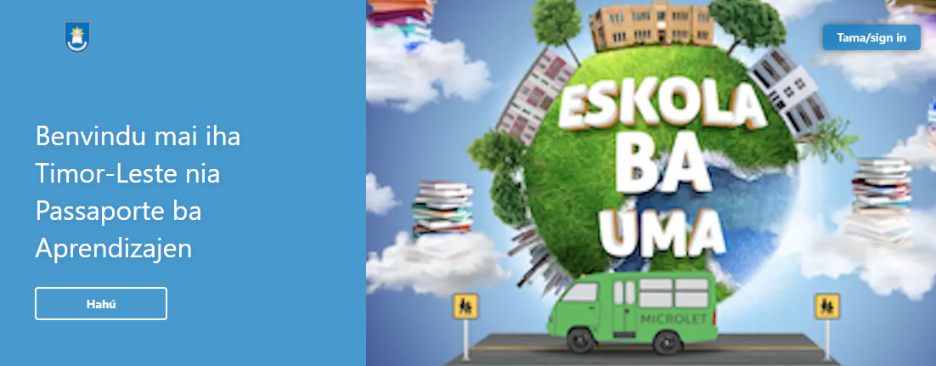
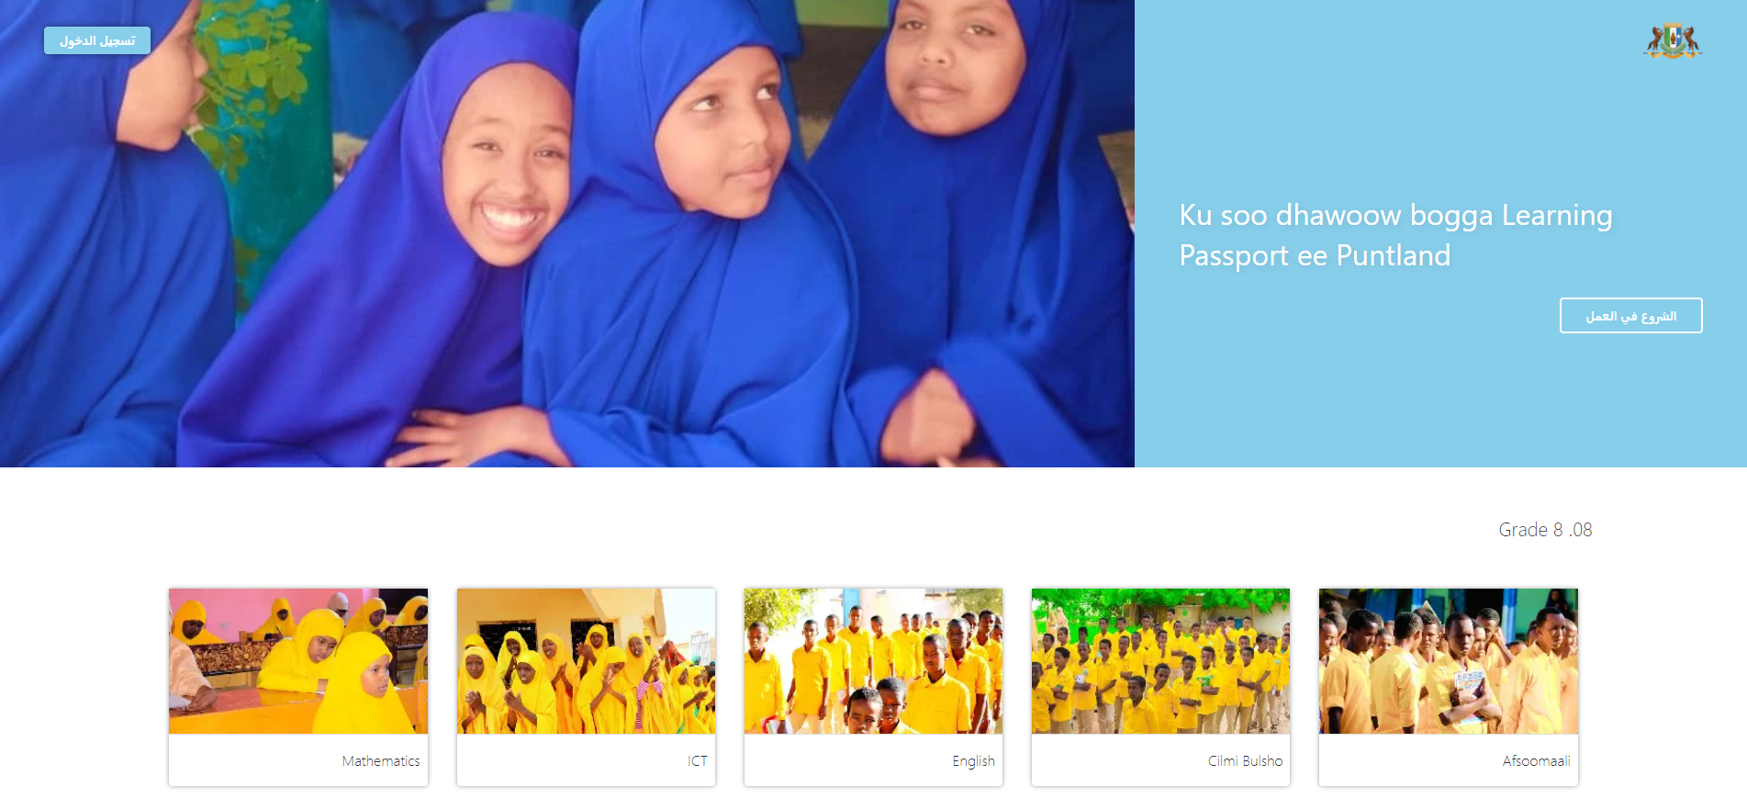
Used as the national/complementary digital learning platform and in multiple modalities
Country:
Timor-Leste
Modality:
Online & Mobile
Use Case:
National Primary & Secondary Digital Learning Platform & Teachers
Country:
Puntland
Modality:
Mobile first
Use Case:
National Secondary Digital Learning Platform

Slide 10
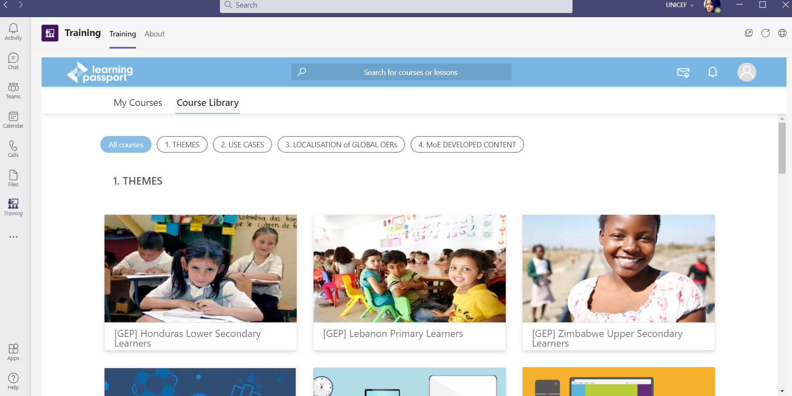
Learning Passport in Kosovo – Integration with Microsoft Teams
Chat and Call functionality available to all users
All courses visible to all users
Integration within MSFT Teams

Slide 11
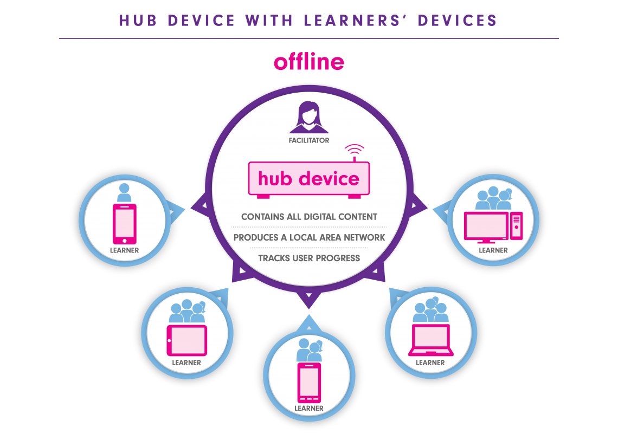
Offline Learning
The Learning Passport’s Offline Model enables learners and teachers to continue their education in low to no connectivity areas, helping to bridge the digital learning gap.
The offline model utilises two concepts to provide digital learning experiences in areas without connectivity.
1) Hub/Learner Device Concept
A hub device located in an offline classroom serves as a
1) Server and 2) Local Area Network (LAN)
Learners will be able to connect their devices such as phones or tablets to the hub device via a web browser on their device.

Slide 12
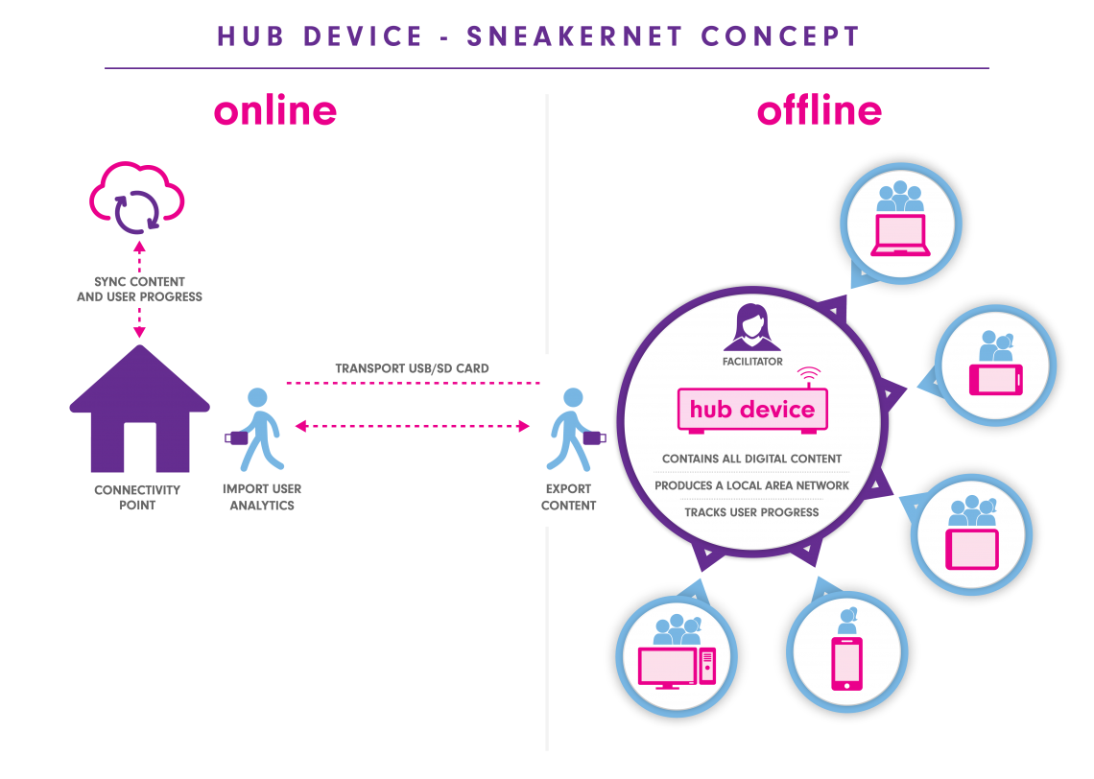
2) Sneakernet Concept
The hub device will be intermittently synced to download new content and upload learners’ record through the physical transport of data on storage devices.
Data from portable storage devices will then be synced to an online database at connectivity points.

Slide 13
What We Offer
Learning Passport Modalities:
- Online Portal
- Mobile App
- Offline Model
Microsoft Azure-powered online and offline platform, and Android app
Access to UNICEF’s perpetual use license for the Learning Passport
Platform hosting and maintenance, and engineering support

Slide 14
Want to find out more or get involved?
  Mac Glovinsky
  Global Learning Passport Lead
  mglovinsky@unicef.org
  Visit our website learningpassport.org

Slide 15
On behalf of the
Learning Passport team
and our partners
Thank you!

Slide 16
Appendix

Slide 17
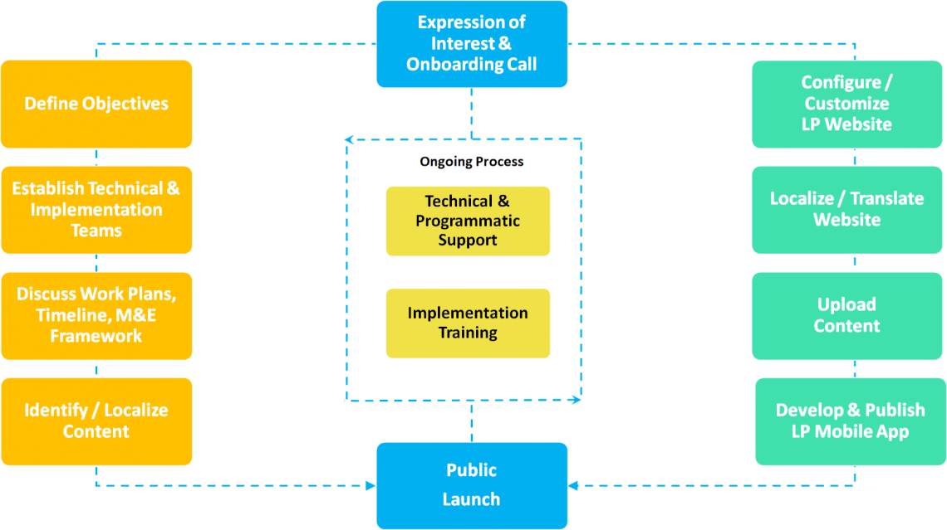
Deployment Process
The Learning Passport occurs once a country officially expresses an interest. Country offices, implementation & technical teams, and other stakeholders will have access to support from our Global Team throughout the entire deployment journey.

Slide 18




Collaboration and combined expertise among partners enables high quality, credibility, and a path to scale
Expertise in children
and adolescents
Global network with field office presence in 128 countries
Potential to encourage at scale adoption of Learning Passport
Expertise in education
Strong credibility and high-quality education content providers
Expertise in technology
Ability to develop
at-scale tech platform
Expertise to provide facilitator support and ensure recording and verifying of education
Future additional partners
Complementary expertise through partners
E.g., local NGOs, governments, other UN agencies
Others
Providing support in go-to-market strategy and business plan

Slide 19




Learning Passport in Kosovo – Deep Dive
Use of existing resources
One stop shop for digital content
All 14,000 video lessons covering grade 1-9 to be added in one place
Unique user IDs for all users
Unique user ids track individual user progress.
A bigger transformation of classroom learning
A comprehensive blended learning solution for all learners, even after COVID-19
Government used existing MSFT licenses to integrate LP within Microsoft Teams
With integration, platform offers content, audio, and video conferencing functionalities to every student and teacher
Administrator privileges to teachers to create courses and assign lessons to learners, as needed

Slide 20
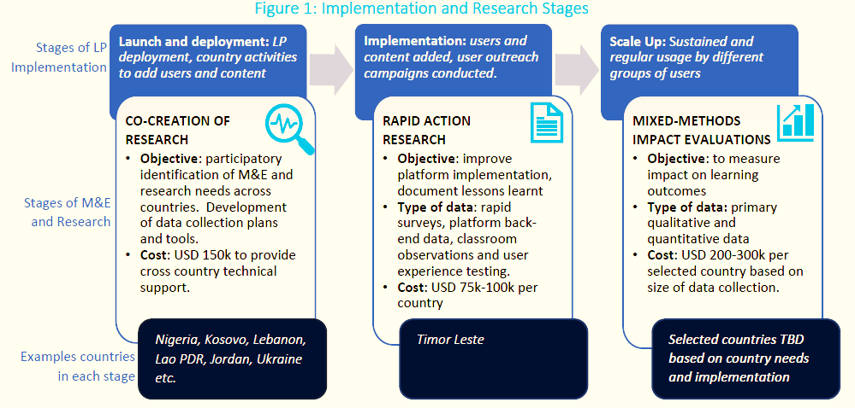
Contributing to Evidence Generation in EdTech

