Slide 1
Using your benefits and getting care
UM1475 0823

Slide 2
You can access your benefits on the go with the UMR app
We have a smarter, simpler, faster way to manage your health care benefits, right from the palm of your hand.
With a single tap, members can:
Look up in-network providers
Check individual or family deductibles
Review co-pays
View claims
Access ID card
Call or email member support
Notes:
Your network is a group of doctors, hospitals and other health care providers who offer network discounts on the services they provide. You are free to visit any provider you choose.
But when you receive care from an ‘in-network’ location, the plan typically pays a bigger share of the cost, and you’ll pay less out-of-pocket.
And if you go to an [ENTER NETWORK NAME] provider for certain preventive services, the cost will be covered 100% by the plan – so there’s zero cost for you.

Slide 3
Finding a network provider
Choose the option that’s easiest for you!
Visit umr.com and select Find a provider. Then enter Choice Plus and start your search.
Call UMR toll-free at 800-582-8547 and ask a representative for help.
Download the UMR app to search for a provider while on the go.
Remember you can find your network information and customer service number on your ID card.

Slide 4
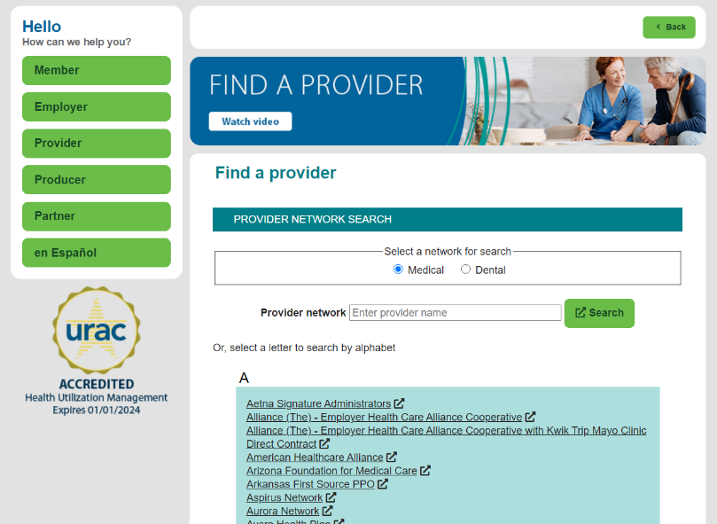
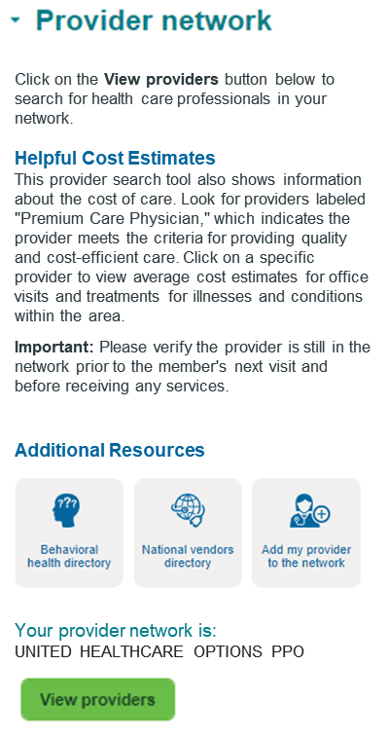
Using your online provider directory
Find the care you need, fast
1
Go to umr.com and select Find a provider or select Find care on the UMR app
Look for the name of your provider network on your ID card
Find your provider network using our alphabetical listing or search box
2
3
Find Care

Slide 5
Look up care where you live
Search by category:
People: Doctors and other health care providers
Places: Hospitals, clinics, imaging centers
Tests and Imaging: Lab tests, screenings, scans
Services and Treatments: Office visits, surgeries
Care by Condition: Area of the body, type of illness

Slide 6
Look for the provider rating for quality
The UnitedHealth Premium symbol looks like this:
This physician meets the UnitedHealth Premium quality care criteria, which includes safe, timely, effective and efficient care.
Premium Care Physician
When you receive care from a Premium provider, you may pay less in out-of-pocket costs for your visit.
Notes:
UnitedHealthcare reviews health care providers in the network for how well they deliver quality and cost-effective care.
Premium Care Physicians are those who meet program criteria for quality & cost-efficient care
Quality Care Physicians are those who meet program criteria for providing quality care
Quality Not Evaluated means the specialty is not evaluated or the evaluation is in progress
Does Not Meet Quality indicates those that do not meet program criteria for providing quality care

Slide 7
Make sure certain services are covered in advance
Services that need prior authorization may include:
Hospitalizations
Inpatient surgeries
Behavioral health stays
Home health care
Durable medical equipment
Dialysis
Transplants and transplant-related services
Cosmetic procedures
Clinical trials
Notes:
If you or a dependent plan to be admitted to the hospital or receive certain outpatient services, UMR may require prior authorization.
Your provider may be asked to provide information to confirm the service or inpatient stay is medically necessary, clinically appropriate and considered effective for treating your condition.

Slide 8
What happens after you receive care
Notes:
Any time you or one of your dependents see a doctor, visit the emergency room or are admitted to the hospital, the health care provider or facility will submit a claim to UMR for processing based upon the information shown on your member ID card.
UMR then determines how the claim will be paid, based upon the rules outlined by your benefits plan.

Slide 9
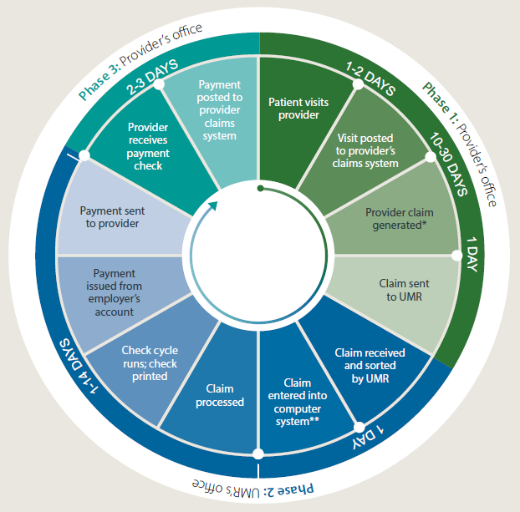
How claims are processed
The life of a claim
UMR will typically process your claim within 30 days of receiving it from your provider.
We may contact you and ask for additional information to complete your claim.
Notes:
Any time you or one of your dependents see a doctor, visit the emergency room or are admitted to the hospital, the health care provider or facility will submit a claim to UMR for processing based upon the information shown on your member ID card.
UMR then determines how the claim will be paid, based upon the rules outlined by your benefits plan.

Slide 10
About your bill
Your plan pays the portion of your health care costs not paid by you.
The amount you are billed may depend upon the:
Type of care you received
Co-payment amount or co-insurance level for the service(s)
Amount of money previously applied to your deductible
Contracted discount for in-network care
Out-of-pocket maximum amount for your benefits
Notes:
Any time you or one of your dependents see a doctor, visit the emergency room or are admitted to the hospital, the health care provider or facility will submit a claim to UMR for processing based upon the information shown on your member ID card.
UMR then determines how the claim will be paid, based upon the rules outlined by your benefits plan.

Slide 11
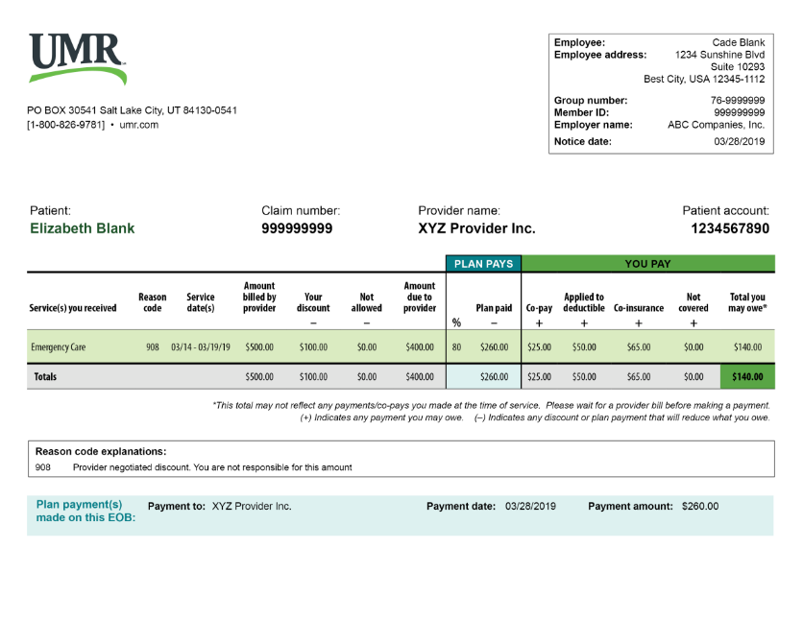
An explanation of your benefits
Your EOB will tell you:
How much your provider billed
Your network discount
The amount paid by your employer-sponsored plan
The amount you may owe, including co-pays, deductibles and out-of-pocket amounts
Remember you will receive a copy of your EOB by mail only if you have a balance to be paid to your provider.
Notes:
After UMR has processed your claim, you will receive an explanation of benefits (EOB) statement. An EOB is not a bill, but it will tell you:
How much the service cost
How much of the cost will be paid by your benefits plan
How much you may owe, if anything
What special codes mean

Slide 12
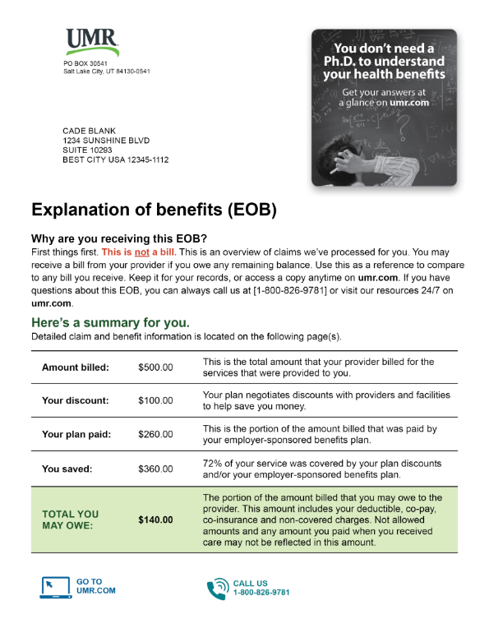
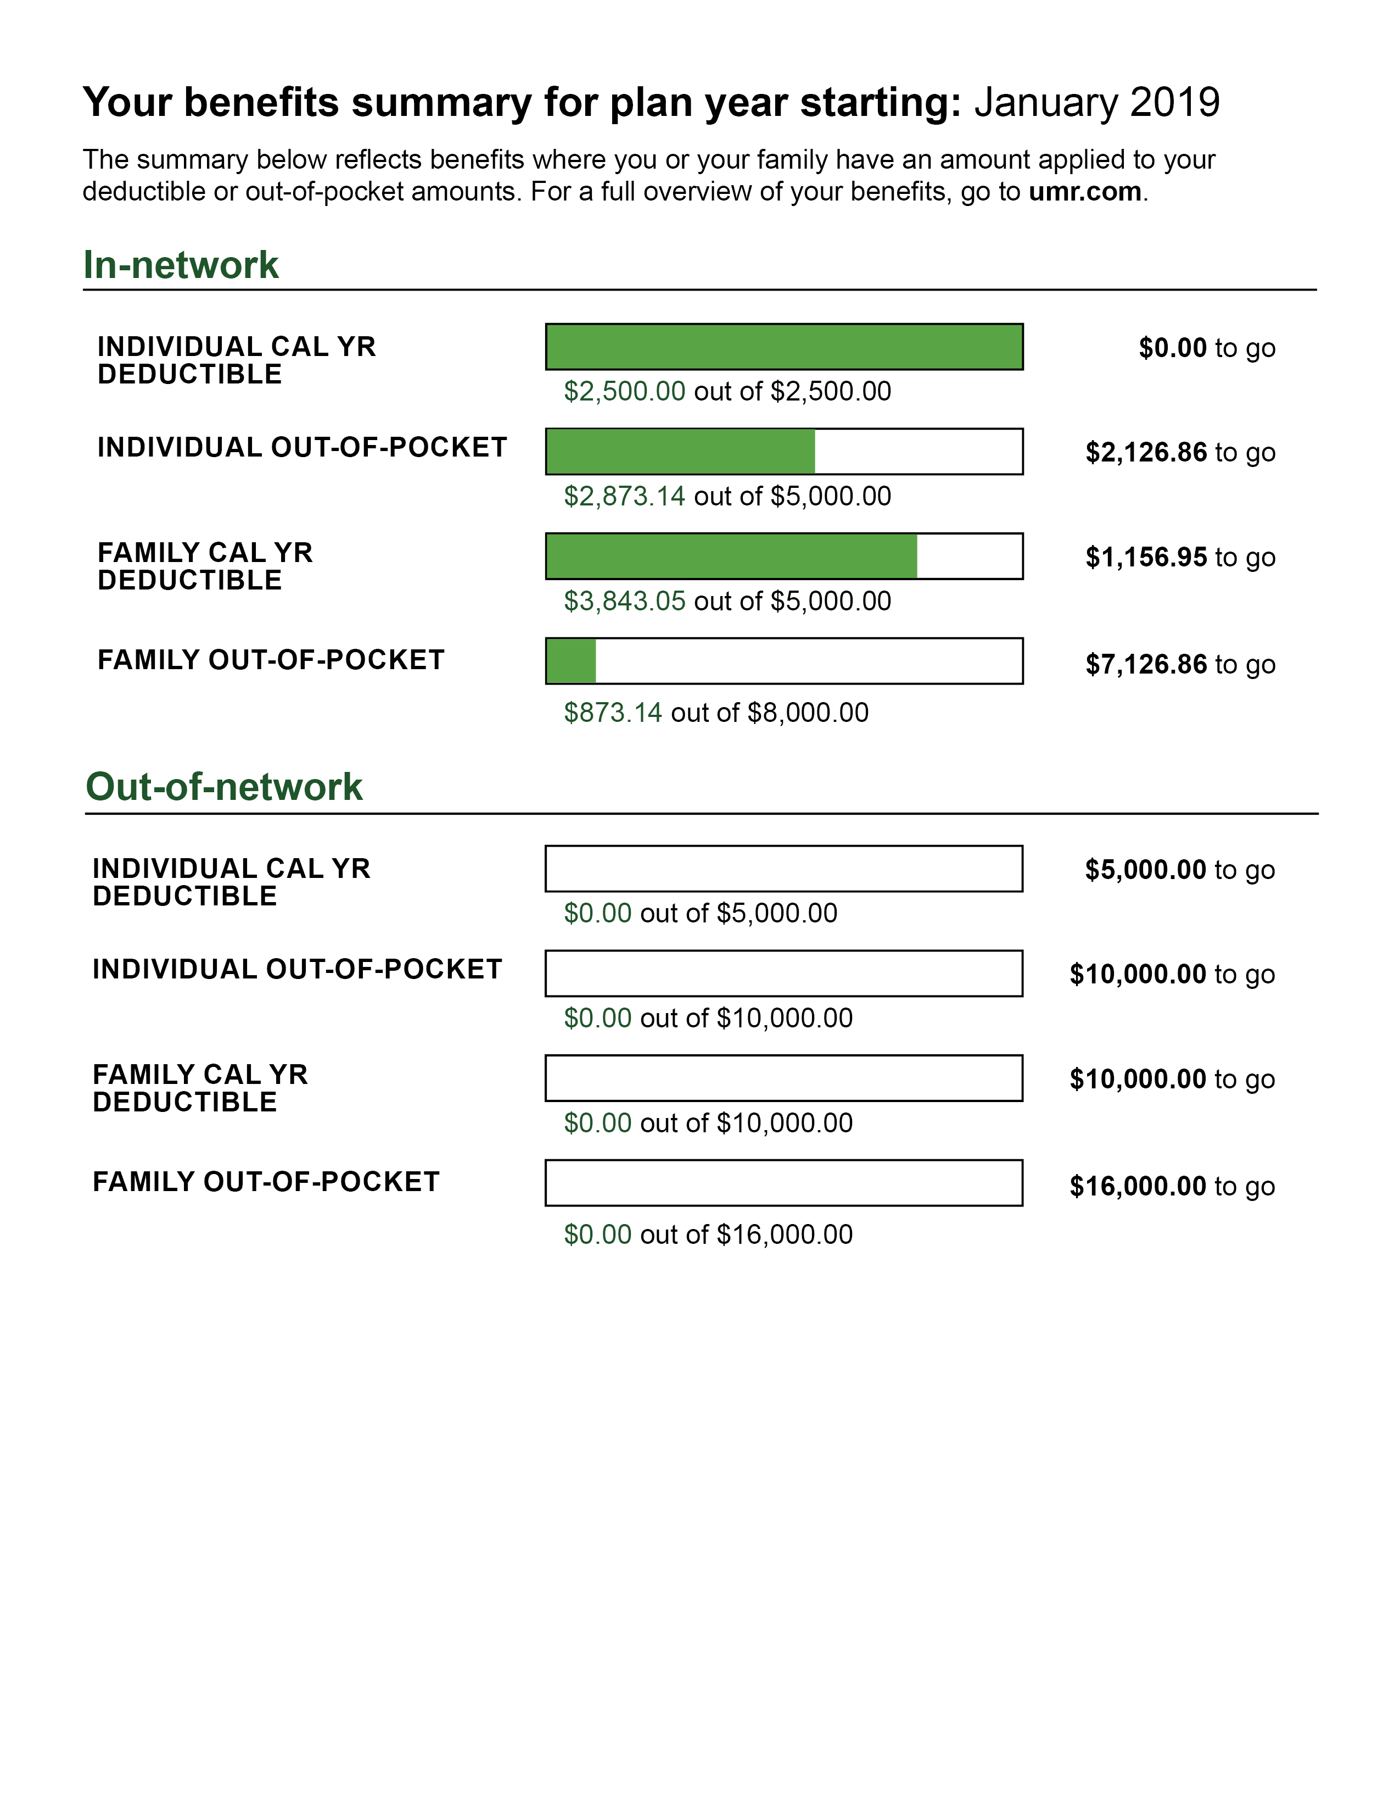
Understanding your medical EOB
Notes:
After UMR has processed your claim, you will receive an explanation of benefits (EOB) statement. An EOB is not a bill, but it will tell you:
How much the service cost
How much of the cost will be paid by your benefits plan
How much you may owe, if anything
What special codes mean
You will receive a copy of your EOB by mail only if you have a balance to be paid to your provider.

Slide 13
You may be asked if you’ve been in an accident
If a recent medical claim was the result of an injury, a third party may be responsible for part of the costs.
If your claim is NOT accident related, UMR will process the claim according to your benefits plan.
To provide information, select the Accident details tile after you log on to umr.com, or call 800-582-8547.
Accident details
Notes:
UMR may contact you and ask whether medical care you received was related to an accident.
This may include:
Work-related injuries
Motor vehicle accidents
Falls
Medical malpractice
Product recalls

Slide 14
Expert support when care gets complex
Nurse case managers guide patients through complicated medical events.
Reviewing your treatment needs
Helping you understand your benefits options
Coordinating care among different providers
Communicating issues to your medical plan
Notes:
UMR’s nurse case managers serve as advocates for patients and their caregivers during medical events involving multiple health care providers and procedures over an extended period.
UMR’s nurse case managers can support you by:
Reviewing your treatment needs with your doctor
Helping you and your family understand your benefits options from diagnosis to conclusion
Coordinating care among different providers
Communicating any complex issues to your medical plan

Slide 15
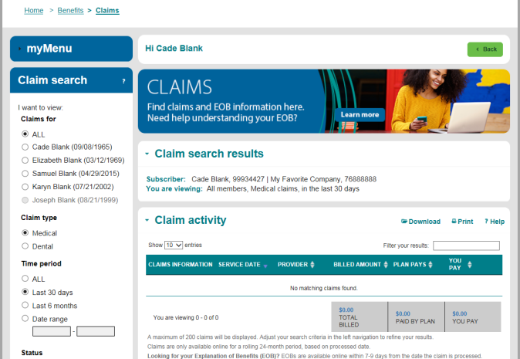
How to check claims status on umr.com and the UMR app
View claims by service date, family member, status and more
Clearly organized and easy to sort
Find out what you owe
Get all the details in one place
Safe and secure
No lost paperwork

Slide 16
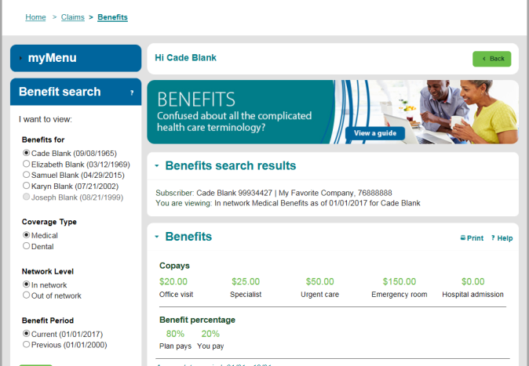
Review deductible and out-of-pocket amounts
Get your answers fast
Is there a co-payment for your office visit? If so, how much?
What’s your deductible, and are you close to reaching it?
How much have you paid toward your out-of-pocket maximum?

